Slide 1
Northern Trust Case Studies 2025

Slide 2




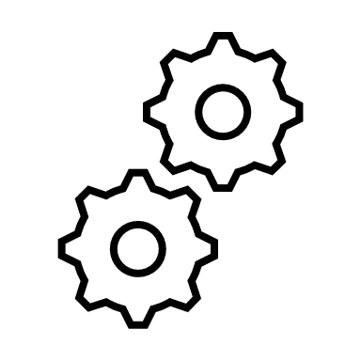
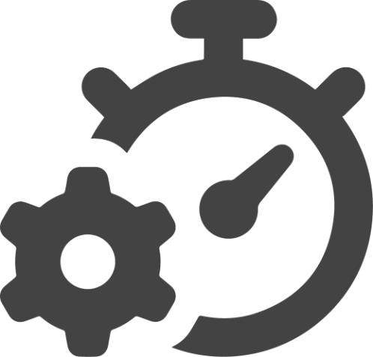



CASE STUDY: Transaction Hub Modernization: From Legacy Infrastructure to Cloud-Native Architecture
PROBLEM STATEMENT:A leading global financial institution, sought to modernize its centralized transaction routing hub. The transaction hub, a critical internal platform, had been running on legacy infrastructure for over a decade. Rising licensing costs, outdated technology, and a growing need for cloud migration and data security catalyzed the initiative to transition from MarkLogic to Azure Cosmos DB.
OBJECTIVES
SOLUTION
IMPACT
PROCESS
DELIVERED
Cloud Migration: transition the transaction hub to a secure, scalable Azure cloud first architecture
Two architects conducted a thorough technical assessment to identify possible migration paths
Replaced MarkLogic NoSQL with Azure Cosmos DB, enabling multi-region replication, and improved scalability
Legacy metadata and non-essential artifacts stripped during migration, resulting in streamlined, JSON format that enhances maintainability, and supports automation
Upgraded all Spring Boot services from Java 1.8 to Java 21, which supports long term releases, improves runtime performance
Enhanced DevOps alignment due to re-architected application being CI/CD ready and designed for automated testing. Integration and unit tests re-written to support Cosmos DB, paving the way for agile delivery practices and reducing future deployment risks
Transaction Hub cost reduction from $1 million/year to less than $120K across 8 applications
$880K IN ANNUAL COST SAVINGS
System Improvement: enhance performance, maintainability, and scalability of the internal transaction hub
Selected a phased Extract Transform Load (ELT) based data migration and application refactor approach
Able to handle 4-5X increase in transaction volume over the next 3 years
FUTURE-PROOF SCALABILITY
Extracted data using MarkLogic Content Pump (MLCP) and cleaned JSON files to remove legacy metadata
Improve Security: by eliminating technical debt tied to outdated software
Lower latency and improve microservice performance and faster transaction processing
Transformed and loaded via Azure Data Factory into Cosmos DB
FASTER TRANSACTION TIME
Enable Agile DevOps Practices: with updated tools and test automation
Replaced MarkLogic dependencies in the application codebase
CI/CD pipelines embedded into architecture, allows faster iterations and safer deployments
Aligned application architecture and tests with Cosmos DB APIs
AUTOMATED TESTING FRAMEWORK
Cost Optimization: reduce high annual licensing cost associated with MarkLogic
Upgrading to Java 21 and adopting Azure native security features improves compliance with modern cyber security standards and industry regulations
Transitioned all Spring Boot microservices from Java 1.8 to Java 21
ENHANCED SECURITY & COMPLIANCE

